Slide 1
Sun to me
Zach Bryan

Slide 2
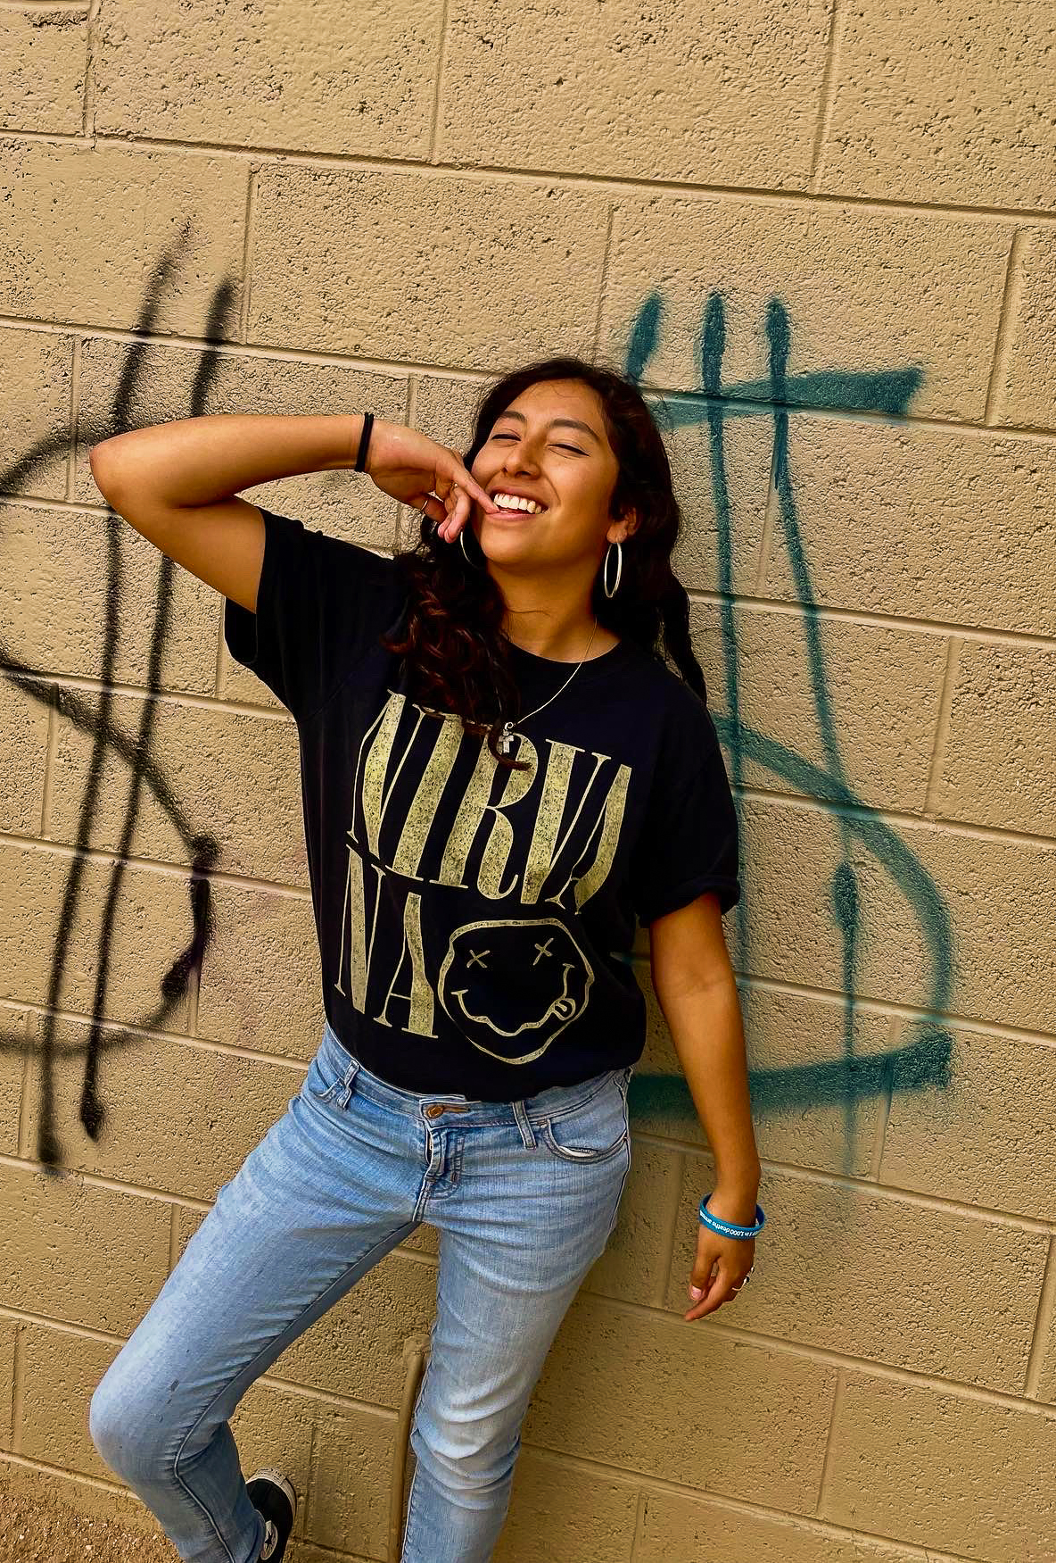
But I've been livin', waitin' on the day

Slide 3
That the good Lord willin', send you out my way

Slide 4
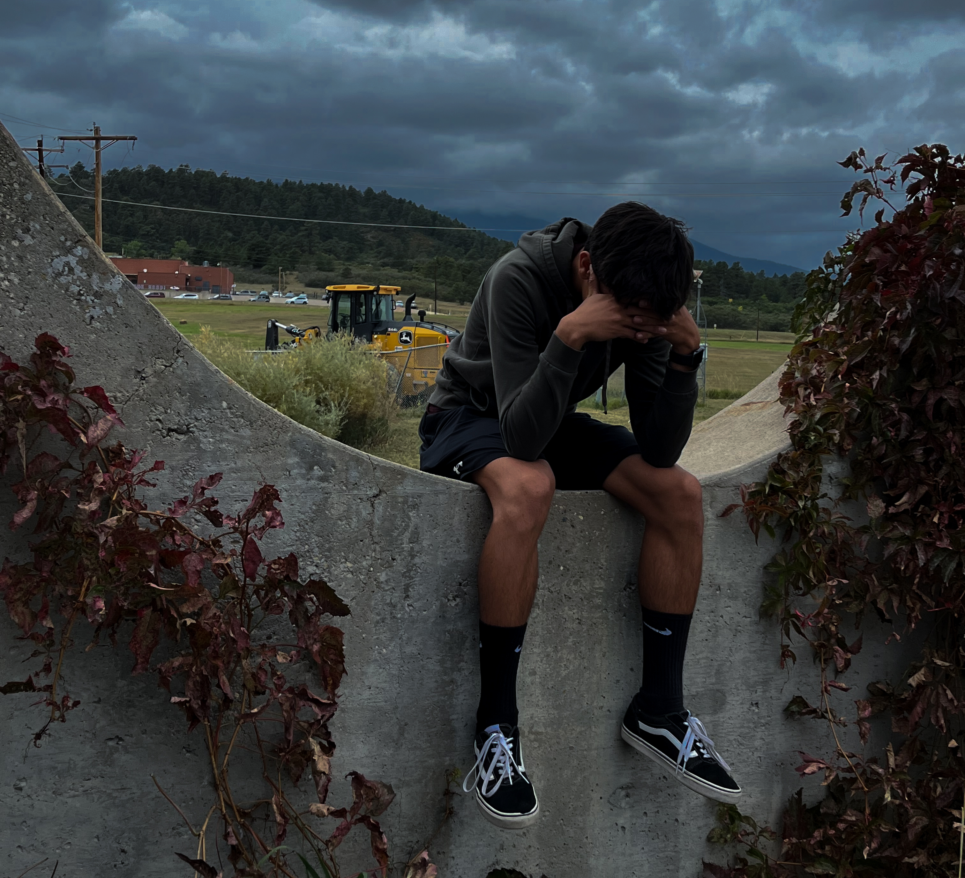
I've seen hard timеs, bad luck, all that in-between

Slide 5
Sweetest of the sunflowеrs

Slide 6
yeah, you're the sun to me

